Slide 1

Wireless Networking
Ambuj Varshney
Assistant Professor, National University of Singapore
Wireless, Embedded Intelligence, Sensing, and Emerging Technologies Group
ambujv@nus.edu.sg

Slide 2
Administration and Course Logistics

Slide 3
Assignment 3a
Link: https://weiserlab.github.io/ambuj/cs4222_assignment3a
Deadline :31st of March 2023
Covers: 13% of overall grade
Wireless measurements using RSSI
No Plagiarism! We will check for code similarity
No ChatGPT for this assignment
Submission: We will open link on Canvas
Notes:
++ We may all have heard of the term Internet of Things. So how are these wireless embedded systems related to the Internet of Things: Today, IoT includes a broad class of devices, including powerful platforms such as smartphones. However, it also includes more resource-constrained devices and what we call Wireless Embedded Systems, and in fact, I consider it to be one of the essential parts of the IoT ecosystem.
++ These are platforms equipped with a radio transceiver, sensor, microcontroller, and some form of energy storage. These platforms also often form a network, and sensor network as it is called has been an active area of research for the past two decades.
++ The research community has also developed wireless embedded platforms which we may know about, and these include: CMUCAM, which is an image sensor platform developed at Carnegie Mellon University, or Permamote is long life sensor platform from the lab I am associated with at UC Berkeley or Lorea which is a long-range backscatter platform that I had developed as part of my doctoral dissertation at Uppsala University. All of these are an example of Wireless Embedded Systems.

Slide 4
Assignment 3b and Tutorial
To be announced this week. Deadline: 31st of March 2023
Tutorial this week: Medium Access Control
Notes:
++ We may all have heard of the term Internet of Things. So how are these wireless embedded systems related to the Internet of Things: Today, IoT includes a broad class of devices, including powerful platforms such as smartphones. However, it also includes more resource-constrained devices and what we call Wireless Embedded Systems, and in fact, I consider it to be one of the essential parts of the IoT ecosystem.
++ These are platforms equipped with a radio transceiver, sensor, microcontroller, and some form of energy storage. These platforms also often form a network, and sensor network as it is called has been an active area of research for the past two decades.
++ The research community has also developed wireless embedded platforms which we may know about, and these include: CMUCAM, which is an image sensor platform developed at Carnegie Mellon University, or Permamote is long life sensor platform from the lab I am associated with at UC Berkeley or Lorea which is a long-range backscatter platform that I had developed as part of my doctoral dissertation at Uppsala University. All of these are an example of Wireless Embedded Systems.

Slide 5
Review of Last Lecture

Slide 6
B-MAC: Medium Access Control
B-MAC is an asynchronous MAC protocol based on preamble sampling. It is one of the earliest medium access control protocol for internet of things
A node turns on its radio periodically to check for activity. If it receives a packet, it stays awake. Otherwise, it goes back to sleep after a timeout
To ensure successful reception, the preamble length must be equal to or much longer than the channel sampling interval
Idle listening occurs when the node samples the channel and finds no activity
For reliable reception, preamble length (Tp) is matched to the interval that the channel is checked for activity
If the channel is checked every 100ms, preamble must be at least 100ms long
Idle listening occurs when the node wakes up to sample the channel

Slide 7
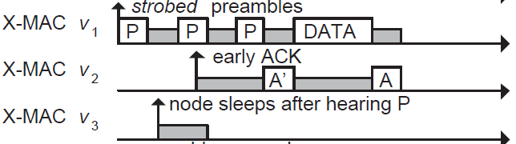
Improving B-MAC with X-MAC
X-MAC improves over B-MAC
Sender transmits many “probes” with gaps between probes. Each probe contains address of intended receiver
Receiver checks address embedded in probe, sends acks if it is the destination during the gap period between probes
Sender transmits DATA, receive replies with Ack to complete data transfer

Slide 8
ContikiMAC
ContikiMAC is the MAC protocol implemented in Contiki OS

Slide 9
Receiver Initiated MAC (RI-MAC)
Change to receiver based (RI-MAC)
Transmitter wakes up and listens for a period of TP
Receiver wakeups up every TP and sends a small packet to announce its presence
Transmitter initiates transmission if the “right” receiver wakes up
Advantage
Less transmission and hence less collision
May consume less energy

Slide 10
Receiver Initiated MAC (RI-MAC)

Slide 11
WiFi Channel Usage

Slide 12
Cross Channel Interference (CTI)
A. Hithnawi, et.al.,TIIM: Technology-Independent Interference Mitigation for Low-power Wireless Networks, IPSN 2015

Slide 13
Cross Technology Interference

Slide 14
Multi Channel MAC Protocols
Why do we need multiple channel for wireless communication?
Increase throughput
spatial diversity
Increase reliability
Use a control channel:
Use of a default channel and time synchronization for control message exchange
Nodes switch to a different channel for data communication
All channels are used for data communication:
Nodes switches to another channel when link quality is bad
How do we find a “good” channel to switch to?

Slide 15
TSCH Network
Time is divided into slots, multiple slots form a slotframe
Sends to receiver on slots it is listening on (e.g. green to C, red to A)
Frequency chosen for a timeslot is based on a pseudo-random pattern
Scheduling policy is not standardized

Slide 16
802.15.4 Overview
Goals
Explicit support for low-cost, low-power, low-throughput devices
Focus on low complexity for specification
Only PHY and MAC are part of specification
Target home automation
Secondarily industrial control/monitoring, vehicular sensing, and agricultural uses

Slide 17
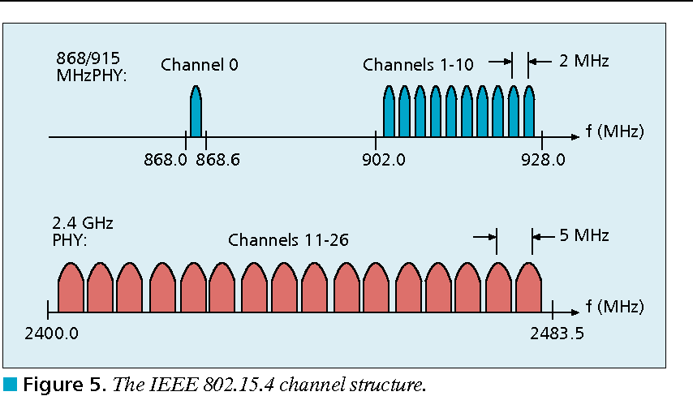
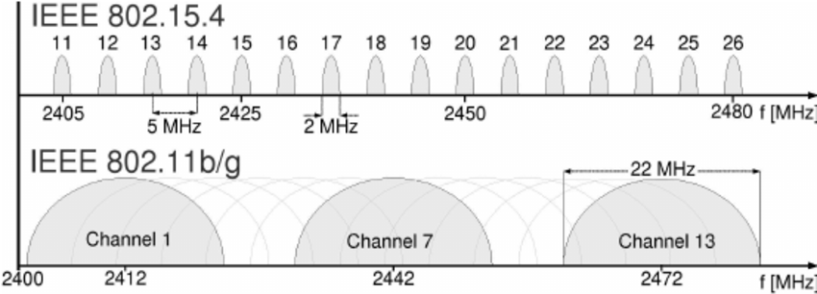
802.15.4 RF channels
27 channels across three bands
5 MHz channel separation at 2.4 GHz
Compare to 2 MHz for BLE

Slide 18
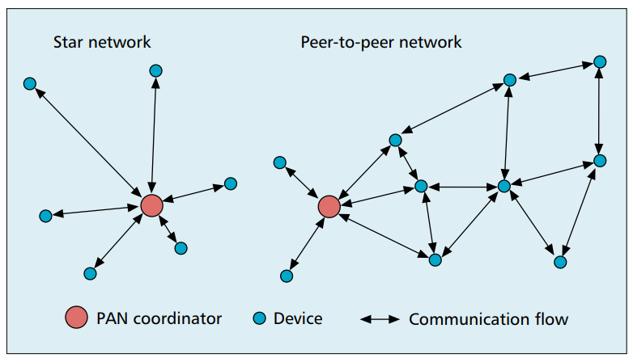
802.15.4 network topologies
Only specifies PHY and MAC, but has use cases in mind

Slide 19
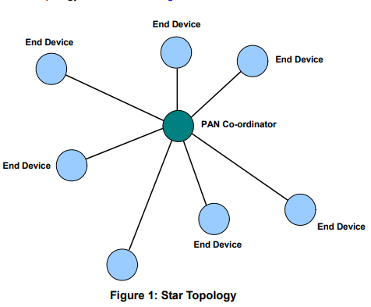
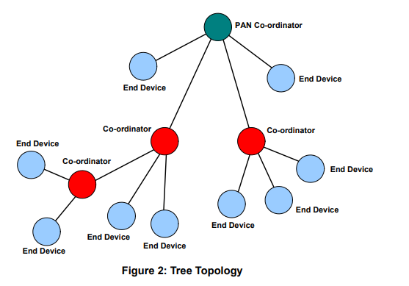
Star and Tree topologies
PAN Coordinator
Receives and relays all messages
Most capable and power-intensive
Coordinators (a.k.a. Routers)
Control “clusters”
Receives and relays to its children
Communicates up to parent coordinator
End Devices
Only communicate with single parent coordinator
Least capable and power intensive

Slide 20
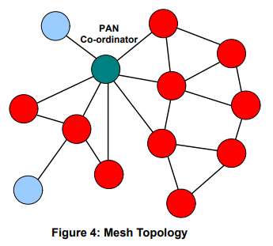
Mesh networks
Most devices are capable of communicating with multiple neighbors
What are advantages of mesh?
Devices can communicate over longer distances
Device failures less likely to collapse the entire network
What are disadvantages of mesh?
Some nodes have to spend more energy communicating
Network protocol becomes more complicated to manage routing

Slide 21
Modes of operation
Beacon-enabled PAN
Slotted CSMA/CA
Structured communication patterns
Optionally with some TDMA scheduled slots
Non-beacon-enabled PAN
Unslotted CSMA/CA
No particular structure for communication
Could be defined by other specifications, like Thread or Zigbee

Slide 22
Beacon-enabled superframe structure
Beacon
Beacon
…
Contention Access Period
Inactive Period
Beacons occur periodically [15 ms – 245 seconds]
Devices must listen to each beacon
Contention Access Period
Slotted CSMA/CA synchronized by beacon start time
Inactive Period
No communication occurring. Assumes sleepy devices

Slide 23
Guaranteed Time Slots (GTS)
Beacon
Beacon
…
Contention Access Period
Guaranteed Time Slots
Inactive Period
PAN Coordinator creates a Contention Free Period with Guaranteed Time Slots
TDMA schedule assigned to specific devices
Slots eat up part of the Contention Access Period
No CSMA/CA within a slot

Slide 24
Non-beacon-enabled PAN
…
Contention Access Period
Same idea, just no beacons
Which removes synchronization benefit (and slotted CSMA/CA)
Also removes beacon listening cost
Devices only need to check for activity before transmitting
Still need an algorithm to determine when it should receive data
All the time is a huge energy drain
Algorithms can get complicated here
Does BLE mechanism of listen-after-send apply?
Only if sending to a high-power device, not among equals

Slide 25
Clear Channel Assessment (CCA)
The “listen” part of CSMA/CA
Variety of implementations are acceptable
Energy above threshold
Energy for 8 symbol durations above threshold (RSSI)
Carrier sense
Valid 802.15.4 carrier signal
Energy AND/OR Carrier

Slide 26
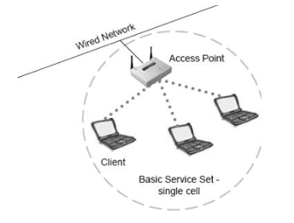
Basic WiFi network
Star topology network
Basic Service Set (BSS)
Access point(s)
Multiple connected clients
Service Set ID (SSID)
Identifies network
Broadcast by access point in beacons

Slide 27
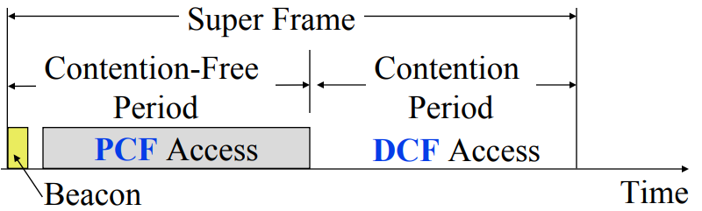
WiFi superframe structure
Beacon followed by contention-free period followed by contention
Repeats periodically (default ~100 ms)
802.15.4 adopted a similar superframe

Slide 28
WiFi superframe in practice
Continuous contention access period
Any device may send at any time
PCF is unused in practice
Periodic beacons
Which also use CSMA and therefore may be delayed
Contention
Based Access
Delayed Beacon
Beacon
Time

Slide 29
Contention-based access
Known as Distributed Coordination Function (DCF)
Base communication method for WiFi (essentially always)
All packets are immediately ACK’d by receiving device
Uses CSMA/CA to determine when it can send
With random backoff
Problem: packets can be very long (up to 20 milliseconds)
Solution: Network Allocation Vector (NAV)
Packets include a notation of their duration
Sensing the beginning of a packet allows backoff to skip the whole packet duration before continuing

Slide 30
Backoff in WiFi
Listen for activity
If free
Wait for Inter Frame Spacing (IFS)
If still free, transmit
If busy
Randomly select a number of backoff Slots
Count down slots whenever medium is not busy
If busy when backoff completes:
Increase maximum backoff Slots
Repeat
Slot time: basic time unit for protocol
Total time of: switch from Rx to Tx, plus processing time, plus propagation delay

Slide 31
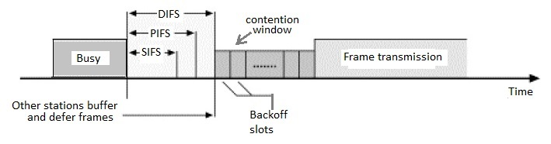
Prioritizing packets with varying IFS
Tiered Contention Multiple Access (TCMA)
Idea: assign different inter-frame spacing based on traffic class
Inherently prioritizes communication
Acknowledgements sent with Short IFS (SIFS)
Will always transmit before new data clears CSMA check
New data sent with DCF IFS (DIFS)

Slide 32
Putting backoff together
Two variables
Contention Window (CW) – maximum backoff amount
Backoff Count (BO) – current remaining backoff
When attempting to send, if busy Backoff selected in [0, CW]
Countdown Backoff slots whenever medium is not busy
At 0, attempt to transmit if not busy
If busy, double Window and select Backoff again
802.11g values:
Slot time= 20 us, CWmin= 15 slots, CWmax= 1023 slots
SIFS= 10 us, DIFS= 50 us

Slide 33
802.11 backoff example
A and B want to send and see the medium is busy
Followed by an Acknowledgement after SIFS
Other Traffic
ACK
SIFS
DIFS
A
Arrival A
B
Arrival B
C

Slide 34
802.11 backoff example
Each chooses a random backoff [0, CW] (we’ll say CW is 32)
Start counting down backoff slots
Other Traffic
ACK
SIFS
DIFS
A
Arrival A
Backoff = 10
B
Arrival B
Backoff = 8
C

Slide 35
802.11 backoff example
C wants to send, waits DIFS, and can send immediately
No other traffic is going on
A and B pause backoff for packet duration
Other Traffic
ACK
C Traffic
SIFS
DIFS
DIFS
A
Arrival A
Backoff = 10
B
Arrival B
Backoff = 8
C
Arrival C

Slide 36
802.11 backoff example
A and B used NAV to pause backoff for entire traffic plus ACK
After DIFS, resume backoff count from its previous value
Other Traffic
ACK
C Traffic
ACK
SIFS
DIFS
DIFS
SIFS
DIFS
A
Arrival A
Backoff = 10
Backoff = 6
B
Arrival B
Backoff = 8
Backoff = 4
C
Arrival C

Slide 37
802.11 backoff example
B reaches zero backoff, finds channel empty, transmits
A pauses its backoff again for duration plus ACK
Other Traffic
ACK
C Traffic
ACK
B Traffic
SIFS
DIFS
DIFS
SIFS
DIFS
A
Arrival A
Backoff = 10
Backoff = 6
B
Arrival B
Backoff = 8
Backoff = 4
C
Arrival C

Slide 38
Learning Objective for Today’s Lecture
Review: last few lecture’s topics
Node Discovery
Routing
IoT/Sensor Network Routing
Flooding
RPL
Misc and Case Study

Slide 39
Node Discovery

Slide 40
How to discover nodes or devices nearby
Scenarios for local discovery
You just enter a shopping mall. You would like to check if there is WiFi service. How does your mobile phone discover the presence of WiFi networks?
Small sensor devices with only low power network interface (e.g. ZigBee) are deployed in the surrounding and carried by humans. How can these devices discover other devices in communication range (in an energy efficient way)?

Slide 41
How to perform local neighbor discovery?
Problem is “easy” to solve if there is no constraint and all nodes can be active all the time.
Challenge is to design a protocol that is energy efficient.
Two broad methods for local neighbor discovery:
Synchronous
Asynchronous

Slide 42
Synchronous neighbor discovery
All nodes are synchronized to the same clock/time.
Nodes wakeup periodically at same time to transmit/receive packets
Node A discovers node B when it hears a transmission from node B
Example:
Assume time is divided into slots of 100ms and there is a global starting reference time t₀ sec
With a 10% duty cycle, period is 1s,
each node wakes up at t₀ + k sec for 100ms, where k = 0,1,2,3,4….
With a 1% duty cycle, period is 10s,
each node wakes up every t₀ + 10k sec for 100ms, where k = 0,1,2,3,4….

Slide 43
What are the drawbacks to synchronous neighbour discovery?
Synchronization can be expensive and periodically re-synchronization will be needed to correct for clock drift over time
As all nodes wakeup at the same time to transmit/receive, collision may increase if too many node transmit simultaneously

Slide 44
Synchronous neighbor discovery with Asymmetric Nodes
Some nodes are more powerful and is always “ON”
Example: WiFi APs (always ON) vs. mobile device (stays in OFF state as much as possible)
A mobile device wants to discover nearby APs
APs are always awake
Mobile device broadcasts (how often?) a probe beacon and listens for replies
How about AP periodically broadcasts and mobile replies?
A mobile device is associated with an AP but wants to conserve energy by going into sleep state whenever there is no data communication
How does the device know there is data from the AP if it is in sleep state?

Slide 45
Power Save Mode (Infrastructure)
When a mobile device wants to go into Power Save Mode (PSM), it informs the AP and goes into sleep state (switches off its radio)
Any packets arriving at the AP for the mobile device in PSM are stored in the AP’s buffer
The AP sends a beacon frame after every fixed time interval. The beacon frame has a field called traffic indication map (TIM) to inform the device in PSM about incoming packets.
Device in PSM wakes up periodically to listen to beacon frames and switch to active state if there are incoming packets

Slide 46
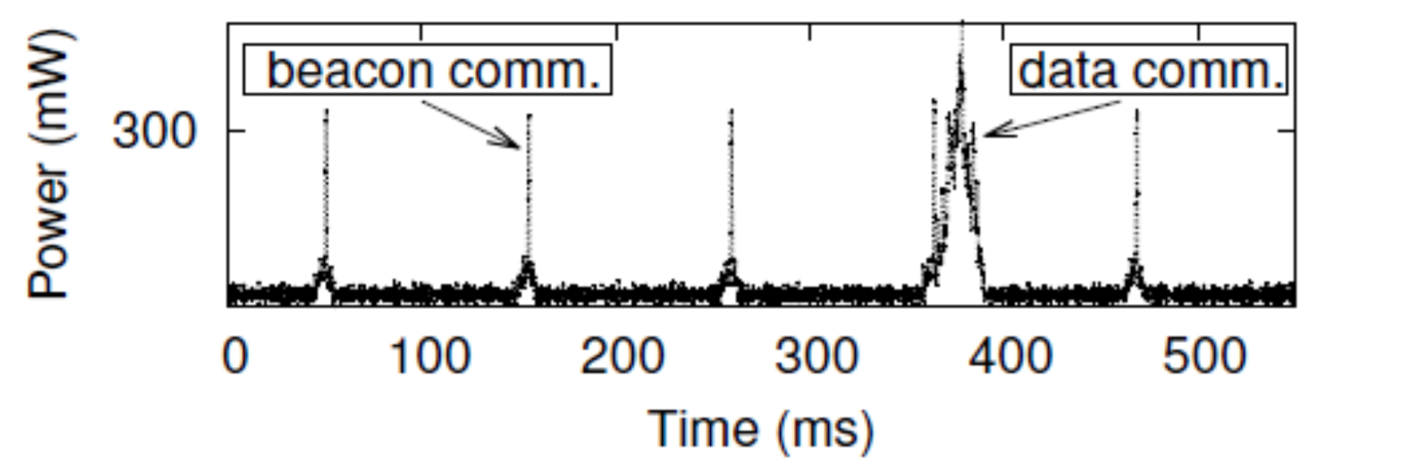
Power Save Mode (Infrastructure)
AP
Device 1
Device 2
TIM – beacon interval for unicast packets
DTIM – beacon interval for broadcast packets

Slide 47
Asynchronous Protocols
Challenges:
No time synchronization
All nodes are resource constrained
Assumptions
Divide into time slots (e.g. 100ms)
Each device decides (randomly?) which time slots to wakeup to transmit/listen
How long will two such devices take to discover each other?

Slide 48
Birthday Paradox
In a group of N people, what is the probability that there is at least one pair of people who have the same birthday? (assume 365 days in a year)
In general, Prob = 1 – P(none of the N people have the same birthday)
N = 2, Prob = 1 – (364/365)
N = 3, Prob = 1 – (364/365)(363/365)
N = 4, Prob = 1 – ((364/365)(363/365)(362/365)
N = n, Prob = 1 – 365!/(365^{n}(365-n)!)
Example:
N = 2, Prob = 0.0027
N = 23, Prob = 0.5073
N = 50, Prob = 0.9704

Slide 49
“Birthday” Protocol
Easy to implement
Good average discovery latency but unbounded worst case
Notes:
Next, we will have a brief literature review for neighbor discovery protocols.
Basically, the neighbor discovery solutions can be classified into two types: the asynchronous protocols and synchronized protocols.
Here is the representative work on asynchronous protocols. Nodes use local clock to schedule wireless interface wake-sleep for neighbor discovery purpose.
Asynchronous protocols are the state of the art… The latest research was searchLight in 2012.
key limitation is not scalable to low duty cycle.

Slide 50
Application to Asynchronous Discovery Michael J McGlynn and Steven A Borbash. Birthday protocols for low energy deployment and flexible neighbor discovery in ad hoc wireless networks. In MobiHoc, 2001
Two nodes randomly choose to wakeup k time slots out of a total n slots. What is the probability that they wakeup at the same time slot at least once?
Probability (Q) can be written down as:
(1%) n = 100, k = 1, Q(100,1) = 0.01
(5%) n = 100, k = 5, Q(100,5) = 0.23
(1%) n = 1000, k = 10, Q(1000,10) = 0.096
(5%) n = 1000, k = 50, Q(1000, 50) = 0.928
Drawbacks – probabilistic bound for discovery time, can take very long sometimes
Can we do better in terms of the worst case?

Slide 51
Asynchronous – Deterministic Bound Yu-Chee Tseng, Chih-Shun Hsu, and Ten-Yueng Hsieh. Power-saving protocols for IEEE 802.11-based multi-hop ad hoc networks. In INFOCOM, 2002.
Period is n² slots, active slots = 2n – 1; Duty cycle = (2n-1)/ n²
n = 4, period = 16 slots, duty cycle = 43.75%
n = 10, period = 100 slots, duty cycle = 19%
n = 100, period = 10,000 slots, duty cycle ~ 2%

Slide 52
Asynchronous – Different Starting Slot
0 | 1 | 2 | 3
4 | 5 | 6 | 7
8 | 9 | 10 | 11
12 | 13 | 14 | 15
0 | 1 | 2 | 3
4 | 5 | 6 | 7
8 | 9 | 10 | 11
12 | 13 | 14 | 15
Starting point shifts by N slots
time slots change from i to (i+N) mod 16
Let N=2 (shift schedule of right table to the reference of the left table)
{2,6,8,9,10,11,14} becomes {4,8,10,11,12,13,0}

Slide 53
Some Limitations
Nodes choose same duty cycle
Duty cycle ~ 1/n
Worst case latency ~ n^2

Slide 54
DISCO[1] – Another Asynchronous Algorithm
Scheduling radio wake times at multiples of prime numbers to ensure deterministic discovery
Nodes can have different duty cycles
Version 0: A node i picks a prime number, say p_{i} and wakes up p_{i} timeslots, the duty cycle is (1/ p_{i}). In the worst case, two nodes p_{i} and p_{j} will meet after (p_{i} * p_{j}) timeslots.
Problem: what if both nodes pick the same prime number?
Version 1: A nodes i picks a prime number, say p_{i1} and p_{i2} (p_{i1} != p_{i2}), wakes up every p_{i1} and p_{i2} timeslots. The duty cycle is (1/p_{i1} + 1/p_{i2})
If both nodes pick the same pair of prime number:
Duty cycle ~ (p_{i1} + p_{i2})/ p_{i1} p_{i2}, Worst Case ~ p_{i1} p_{i2}
[1] Dutta, Prabal, and David Culler. "Practical asynchronous neighbor discovery and rendezvous for mobile sensing applications." Proceedings of the 6th ACM conference on Embedded network sensor systems. 2008.

Slide 55
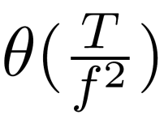
Asynchronous Protocols [1]
Category |  | Representative Protocols | Delay Bound
Asynchronous protocols | Asynchronous probabilistic | Birthday Protocol [2001] | None
 | Asynchronous deterministic | Quorum-based [2002,2005], Disco [2008], U-connect [2010], SearchLight [2012]
f is the duty cycle (e.g. 1%)
T is the time slot length (e.g. 20ms)
[1] Xiangfa Guo, Binbin Chen and Mun Choon Chan, "Analysis and Design of Low-Duty Protocol for Smartphone Neighbor Discovery," IEEE Transactions on Mobile Computing, Dec 2017.
Notes:
Next, we will have a brief literature review for neighbor discovery protocols.
Basically, the neighbor discovery solutions can be classified into two types: the asynchronous protocols and synchronized protocols.
Here is the representative work on asynchronous protocols. Nodes use local clock to schedule wireless interface wake-sleep for neighbor discovery purpose.
Asynchronous protocols are the state of the art… The latest research was searchLight in 2012.
key limitation is not scalable to low duty cycle.

Slide 56
Routing

Slide 57
Routing goals
Have a packet, have a destination, how do we connect them?
Simple techniques
Broadcast, tree structures
Mesh techniques
Understand the available routes and select a “good” one

Slide 58
Performing routing in the wired networks
Routing is trivial if all nodes are connected to each other
Problem: if they are N nodes, need N(N-1) or O(N²) (uni-directional) links

Slide 59
Performing routing in the wired networks
Number of links can be reduced significantly with one “BIG” switch with N links and routing is still simple
Problem: If N is large and nodes can be far apart (think of the Internet)
Adding more switches/routers reduces the size of the switches/routers needed and allow network to grow
But Routing will be more complex!

Slide 60
Performing routing in the wireless networks
Routing protocols are complex, hard to maintain/debug and incurred significant overhead. More so for wireless networks.
In practice, wireless network deployments are single-hop and routing is trivial. All stations/devices communicating directly with base stations
Example: WiFi, Cellular Network, LoRa
Can one-hop communication be always sufficient by using sufficiently long range radio and large number of base stations?
Why multi-hop routing?
is strictly better in terms of reach/coverage for the same number of base stations
provides more routes, potentially more robust

Slide 61
For the same distance, is it better to have direct or multi-hop path?
A
B
A
C
D
E
B
Which option is better?
Typically, a single-hop is considered better

Slide 62
But, for energy Consumption …
Is multiple-hop transmission more energy efficient than a single-hop ?
Let us Recall the free space model: Pr = C P_{t} / dª (C = constant)
Transmission over a distance d, let minimum received power needed be P₀
1 transmission to cover distance d, transmission power (P₁) needed is
P₀ = C P₁ / dª or P₁ = P₀/C * dª
N transmissions to cover distance d, transmission power needed (P_{N}) per hop is
P₀ = C P_{N} / (d/N)ª , or P_{N} = P₀ /C * (d/N)ª
Total transmission power is N P_{N} = N P₀ /C * (d/N)ª
Which approach (1 transmission vs N transmissions) is more energy efficient?

Slide 63
Simple routing solutions
Broadcast
The link-layer solution for everything
Star topology
Only one location to send to: parent
Single parent needs to store information about all children
Addresses, schedules, etc.
Tree topology
Two choices: send to descendent or send to parent
Each parent needs to store information about all children beneath it
Original ZigBee approach (knowledge built into addressing scheme)

Slide 64
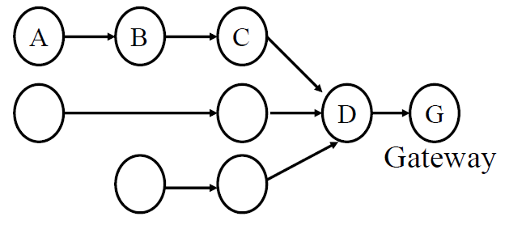
Many-to-one routing
Tree optimization for sensor networks
Keep all devices except the “gateway” as simple as possible
Each device only needs to remember hop to gateway
If gateway wants to send message back, it must include a full hop path

Slide 65
Communicating using wireless mesh
Formed by a network of static wireless nodes
Issues:
Interference
Self-Interference
Selects routes that minimize
Interference
Error

Slide 66
Mesh Routing
Mesh topology makes routing question more complicated
Multiple hops in a route
Multiple routes between source and destination
Becomes a graph theory question based on cost metric
B
C
A
D
F
E

Slide 67
Flooding
Mesh equivalent of broadcast
Each node sends to each other node
Eventually packets will reach the desired destination
Not really routing at all…
Question: how do we make it stop?

Slide 68
Flooding
Mesh equivalent of broadcast
Each node sends to each other node
Eventually packets will reach the desired destination
Not really routing at all…
Question: how do we make it stop?
Maximum retransmissions counter on each packet
Decrement at each hop. Drop packet when it hits zero
Need some guess for how many hops to destination
Keep some history of recently flooded packets
Don’t retransmit a recently sent packet

Slide 69
Reactive routing
Build up a map of the routes through a network
Hopefully the “optimal” routes
Map routes in reaction to a packet arrival
Sensor devices are slow and limited
Most likely to resend to same prior address
Discover a route when it is needed, then cache for next time

Slide 70
Ad-hoc On-demand Distance Vector Routing (AODV)
On-demand: Construct routes only when needed
Modern ZigBee routing approach (for Mesh topology)
Routing table
Destination node -> Next hop (for all cached destinations)
Store only next hop instead of full route
All routers along the path must also have Destination->Next mappings
Also keep hops-to-destination and last-seen-destination-sequence-number
Route discovery
Upon demand: check table
If not cached send Route Request (RREQ) via Flooding
Route is unknown, so flooding is needed

Slide 71
AODV Route Requests (RREQs)
Request ID | Source Address | Destination Address | Source SeqNo | Destination SeqNo | Hop Count
Request ID identifies this RREQ
Used to discard duplicates during flooding
Sequence Numbers are per-device, monotonically increasing
Used as a notion of “how recently” device has been seen
Source SeqNo is the source’s most recent sequence number
Destination SeqNo is the most recently seen from the destination by the source. (Defaults to zero)
Hop Count is the number of hops this request has taken
Starts at 1 and incremented by each transmitter along the path

Slide 72
Example AODV RREQ (A to F)
Request ID | Source Address | Destination Address | Source SeqNo | Destination SeqNo | Hop Count
A wants to find a route to F, so it sends out an RREQ
B
C
A
D
F
E

Slide 73
Example AODV RREQ (A to F)
Request ID | Source Address | Destination Address | Source SeqNo | Destination SeqNo | Hop Count
1 | A | F | 1 | 0 | 1
B and D also opportunistically add a routing table entry for A
B
C
A
D
F
E

Slide 74
Example AODV RREQ (A to F)
Request ID | Source Address | Destination Address | Source SeqNo | Destination SeqNo | Hop Count
1 | A | F | 1 | 0 | 2
B goes first via some access control protocol (D also in contention)
A and D ignore duplicate Request ID C opportunistically adds a routing table entry to A
B
C
A
D
F
E

Slide 75
Example AODV RREQ (A to F)
Request ID | Source Address | Destination Address | Source SeqNo | Destination SeqNo | Hop Count
1 | A | F | 1 | 0 | 2
D goes next by some access control protocol (C also in contention)
A, B, and C ignore duplicate Request ID E and F opportunistically adds a routing table entry to A
B
C
A
D
F
E

Slide 76
Example AODV RREQ (A to F)
Request ID | Source Address | Destination Address | Source SeqNo | Destination SeqNo | Hop Count
1 | A | F | 1 | 0 | 3
C and E repeat this process with Hop Count 3 (but everyone ignores them)
They go one-at-a-time, but I’m getting tired of drawing these
Actually, they’re in contention with the response from F
B
C
A
D
F
E

Slide 77
AODV Route Response (RREP)
Source Address | Destination Address | Destination SeqNo | Hop Count
Reply is sent unicast back to the source via newly constructed route
Each node along the way already knows the route back
Includes most recent destination sequence number as a sense of recency
No need for source sequence number anymore

Slide 78
Example AODV RREP (F to A)
Source Address | Destination Address | Destination SeqNo | Hop Count
F | A | 7 | 2
F sends response back to A via D
D opportunistically adds a routing table entry for F
B
C
A
D
F
E

Slide 79
RREP optimization
An intermediate node responds with RREP if it has a path to destination with a more recent Destination sequence number
Source may get multiple RREP responses with different recency and hop counts
Note: we’re optimizing for some combination of most recent and lowest hop count

Slide 80
Route maintenance in AODV
If a link in the routing table breaks, all active neighbors are informed with Route Error (RERR) messages
After some number of retransmissions and timeouts
RERR contains destination address that broke
Nodes receiving RERR can start RERQ for destination address
Which lets them find a new path through the network
And updates everyone’s cached next-hops

Slide 81
Dynamic Source Routing (DSR)
Another reactive routing technique
Similar design as AODV
In DSR, routing tables have full route to destination
Each packet transmission includes a list of hops to destination
So the route to an important destination only has to be stored on the source device that cares about it
Intermediate nodes do not need any route storage for that destination
Cost is extra bytes used in each packet for route
During discovery, all paths are returned by destination
So source gets a full list of possible route choices

Slide 82
Tradeoffs for reactive routing
Upside: no transmissions unless there is demand
Routes might appear, disappear, reappear, but no need to update if no one actually wants to transmit anything
Downside: large, variable delay when actually sending a packet
Full RREQ/RREP protocol before data can actually be sent
Route might have broken at some point
So data will be sent based on cached information
RERR will occur
RREQ/RREP will occur
Then data will be sent again

Slide 83
Proactive routing
Alternative to reactive is to know the routes ahead of time
Periodically query for the possible routes in the network
Save all routes that are important (maybe just all routes?)
Also redetermine routes whenever topology changes (nodes join/leave)
Upside: when a packet arrives, route to destination is already known
Downside: requires more memory and effort on part of routers
Wastes some network bandwidth on checking for route changes

Slide 84
Distance-Vector
Keep routes as “next hops” rather than full routes
AODV uses this method (DV for Distance Vector)
Can be combined with proactive techniques too
Each router periodically informs neighbors of its shortest paths to each destination (in terms of hop count)
Essentially just broadcast your routing table
Routers choose the best route available
Old next-hop it was already aware of
New next-hop through neighbor (with cost of their hops + 1)
Need to be careful to avoid loops!

Slide 85
Reliability as a cost metric
Link quality can very from node to node
Fewest hops might not be the “fastest” or “most reliable” path
ETX: minimize “expected transmissions”
Measure link quality over time to determine each link’s reliability
B
C
A
D
F
E

Slide 86
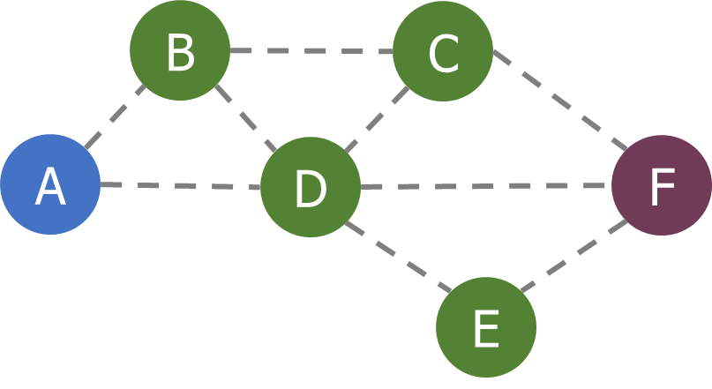
Alternative cost metrics
Spatial reuse
Prefer transmission on links that do not interfere with each other
Improves ability to pipeline data through network
Example: A<->B and E<->F
Energy availability
Prefer routing through nodes with more remaining available energy
Prefer wall-powered nodes over battery-powered
Arbitrarily complex combinations possible

Slide 87
Wireless routing for mesh networks
The simplest routing protocol is a tree-based protocol (e.g. spanning tree)
Tree is suitable for data collection application, a common application in IoT
What are some possible routing metric?
Hop Count
Delay
Reliability
Energy

Slide 88
Expected number of transmissions: ETX
ETX (expected transmissions) is a commonly used routing metric
Consider the path A -> B -> C
Packet reception ratio (PRR)
A -> B is 0.8, ETX = 1/0.8 = 5/4
B -> C is 0.5, ETX = 1/0.5 = 2
Path ETX (A -> B -> C) is 5/4 + 2 = 13/4
A
B
C

Slide 89
Performing routing using the shortest path
Many practical routing algorithms are based on the notion of shortest path between two nodes
Each link is assigned a positive number called its length
A shortest path routing algorithm routes each packet along the minimum length (or shortest) path between the source and destination
If length is always 1, then shortest path becomes minimum hop routing
By defining the length using other metrics like cost, delay etc, other paths can be obtained

Slide 90
Mobile wireless nodes: Ad-hoc wireless routing
What if the nodes are not static but mobile?
A Mobile Ad hoc Network (MANET) is an autonomous system of mobile nodes (MSs) (also serving as routers) connected by wireless links
No infrastructure exists in a MANET
The network’s wireless topology may change dynamically in an unpredictable manner since nodes are free to move and each node has limited transmitting power
Assumption: Due to node mobility, routing path may be available but needs to be “discovered”

Slide 91
Classification of Ad-hoc routing protocols
The existing routing protocols can be classified as:
Proactive: when a packet needs to be forwarded, the route is already known
Reactive: Determine a route only when there is data to send
Routing protocols may also be categorized as:
(Proactive) Table Driven protocols
(Reactive) Source Initiated (on demand) protocols

Slide 92
Delay Tolerant Network (DTN)
(Mobile) Nodes are mostly disconnected
Range is relatively short. Mobile nodes meet one another opportunistically
Nodes are mostly in “sleep” mode to conserve power
Typically, to improve delivery ratio, messages are duplicated to many (if not all) nodes
Improve performance by estimating contact probabilities
Constraints are:
Number of messages buffered
Contact duration

Slide 93
DTN
Some Examples
Terrestrial Mobile Networks: e.g. bus network
Exotic Media Networks, e.g. deep space network
Military Ad-Hoc Networks
Sensor/Actuator Networks

Slide 94
Epidemic (Vahdat 2000)
Epidemic – sends all the packet to every node one encounters
Claim: Epidemic routing has the best performance but highest overhead
True or False?
Enhancement:
Only relay a message up to x-hops from the source
Use ACK message to remove delivered messages from buffer

Slide 95
Single Copy (Spyropoulos, 2004)
Default is for the source to keep the message and only transmit to destination if the two nodes are in direct contact
Relay the message to another node with probability p
Does this work better?

Slide 96
Many More Possibilities …
Duplicate a few copies instead of using only one
Problem: How many copies do we need?
How should contact probabilities be estimated?
Example 1: Selects next hop based on time of last encounter, transmits to nodes that encounter destination nodes more recently than itself
Example 2: Records last contact information, e.g. location and time, duplicates messages to nodes which are closer to destination

Slide 97
Sensor Networking (IoT) Routing

Slide 98
Routing for constrained internet of things devices
It is similar to mesh routing, design for static, connected network
What are the issues that are important to IoT:
Energy efficiency, duty cycling

Slide 99
Link and Neighborhood Management
In a wireless environment, each node needs to decide if a link (to another node) is available.
Why?
How can this decision be made?
Usually through some form of measurements
A node sends beacon and other nodes check if the beacon can be received

Slide 100
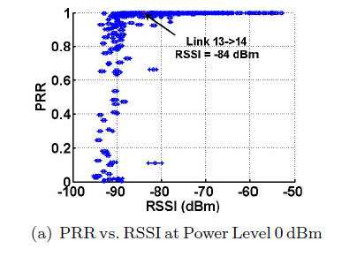
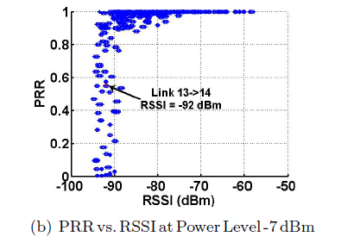
What to measure?
PRR – Packet Reception Ratio
RSSI – Received Signal Strength Indicator
Kannan Srinivasan and Philip Levis, “RSSI is Under Appreciated,” EmNets 2006.

Slide 101
Measuring Low-Power Wireless Link Quality
To measure PRR,
Receiver assumes that a transmitter sends S packets over a given period of time T sec
In T sec, record the number of packets received from transmitter, let this be R
PRR = R/S
Example:
T = 1sec, S=100 (if R=95, PRR=0.95)
T= 10sec, S=100 (if R=55, PRR=0.55)
T= 100s, S=10 (if R=8, PRR=0.8)

Slide 102
Measuring Low-Power Wireless Link Quality
Trade-off between communication cost and reaction time
Assume ZigBee radio is used (250Kbps), each transmission takes 1ms (~250bits, ~30bytes) and link measurement probes should not collide
If T=1s, S=100
Measurement takes up 10% of bandwidth 1 node
If there are 10 nodes, 100 probes need to be transmitted in 1 sec (100% of bandwidth used only for measurement!)
If T=100s, S=10
Measurement takes up very little bandwidth
Is S too small?
If there is a change in link quality, how long does it take to notice?
What are “good” values for T and S?

Slide 103
A “Simple” Beacon-Based Protocol
Node broadcasts beacon messages
When a node receives a “HELLO” message from another node, it identifies the latter as one of its inbound neighbors, and it will include the latter in the “I-HEAR-YOU” message and broadcast the message back to the latter. (detection is one-way!)
In response, when a node receives “I-HEAR-YOU” message from another node (i.e., its ID is included in this “I-HEAR-YOU” message), it identifies the latter as an outbound neighbor.
The two nodes will become both inbound and outbound neighbors for each other, if they can hear each others’ messages from each other
In practice, the “I-HEAR-YOU” message contains the list of inbound neighbors as well as their PRR values, and the “HELLO” message, are often combined into one packet.

Slide 104
Example
B
Hello, I am B
Hello, I am B, I can hear A
A
Hello, I am A
Hello, I am A, I can hear B and C
C
Hello, I am C
What if some of these probe packets are not received?
Hello, I am C, I can hear A and B

Slide 105
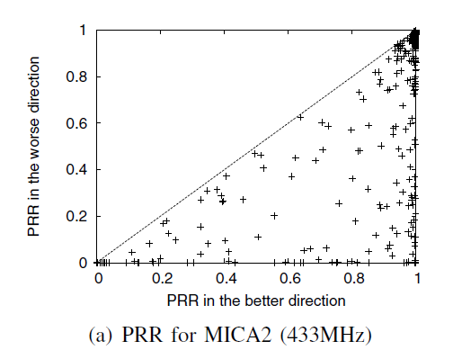
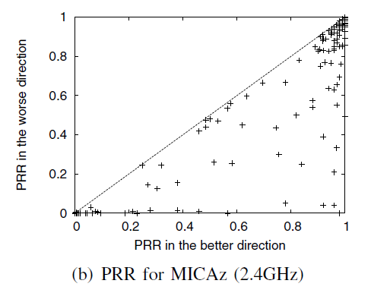
Low-Power Wireless Link Asymmetry
Usually only symmetry links are used
What is a (sufficiently) good link?

Slide 106
Who are my neighbors?
In order to reduce memory and computation cost, neighbor table tends to be small (e.g. 6 – 10)
How many neighbors are sufficient?
Only keep track of “good” neighbors

Slide 107
Who are my neighbors?
Possibility of network partition
Links within each room is good
The one link between the 2 room is weak
If all nodes select the best links, there will be no connection between rooms 1 and 2
Room 1
Room 2
How do you address this problem?

Slide 108
Collection Tree Protocol (2009)
Current default routing protocol in TinyOS
Tested on 12 different testbeds (20 nodes – 310 nodes)
> 90% delivery rate in all cases
> 99% in many cases
Some limitations in evaluation
In testbed evaluation, there is no issue with battery drain
Power is often set to maximum value
Deployment tends to be very dense

Slide 109
CTP
Major subcomponents
4-bit link estimator
Datapath validation
Adaptive beaconing
Addresses the challenges of reducing overhead of neighbor while having fast reaction to link failure

Slide 110
Data Driven Estimation
Estimation is agile and driven by the ACK-bit (data-driven estimation)
If a out of K_{u} packets are acknowledged then
If K_{u} = 5
1.0
1.25
6.0
EWMA

Slide 111
Data Path Validation
A data packet carries its estimated ETX value to the root
Receiver compares the ETX value of packet received to its own estimated. If the ETX value is smaller, the transmitted topology is stale
Allows detection on the first data packet, rather than waiting for the routing protocol update

Slide 112
Adaptive Beaconing
Balance the following needs:
Sends as few beacons as possible (energy efficiency)
Reacts quickly to topology changes
Do not use periodic beaconing
Starts from a fixed and small interval T₀ (minimum interval)
If there is no “change”, double interval till T_{H} (maximum interval)
If a change is detected, drops to T₀
Change is defined as:
Receiver sees larger ETX from transmitter
ETX drops significantly (> 1.5)
Neighbor ask for update (e.g. a new node joins)

Slide 113
Flooding

Slide 114
Flooding is a recreation of broadcasts
Goal: get information to all nodes
This is the problem of “data dissemination”
Problem: difficult in Mesh topologies
Packet loss, retransmission delays
Really, the desire for data dissemination is just to broadcast to all nodes
But broadcast transmissions don’t reach far enough to cover entire mesh

Slide 115
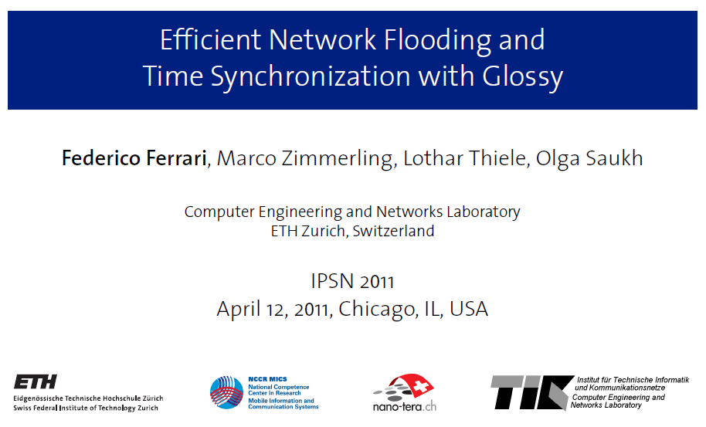
Glossy: what if we expand broadcast range by having multiple nodes participate?

Slide 116
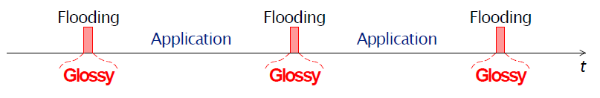
Glossy key techniques
Temporally decouple network flooding from application tasks
Exploit synchronous transmissions for fast network flooding

Slide 117
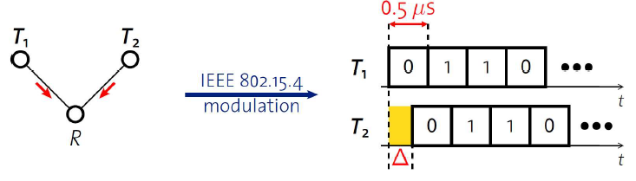
Synchronous transmissions
Multiple nodes transmit same packet at same time
R can receive packet with high probability if Δ is small
May even improve probability of reception (more energy at receiver)
500 ns is 1/32 of a symbol for 802.15.4 (chip duration)

Slide 118
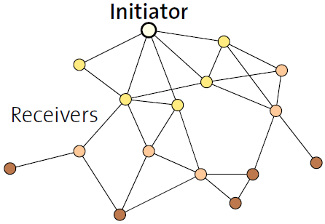
Fast packet propagation in Glossy

Slide 119
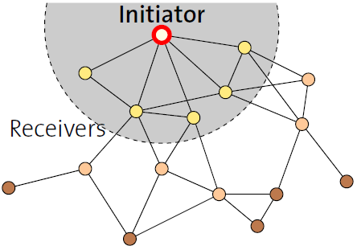
Fast packet propagation in Glossy

Slide 120
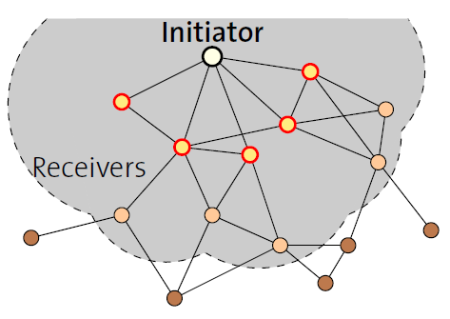
Fast packet propagation in Glossy

Slide 121
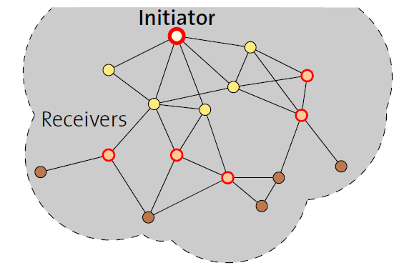
Fast packet propagation in Glossy

Slide 122
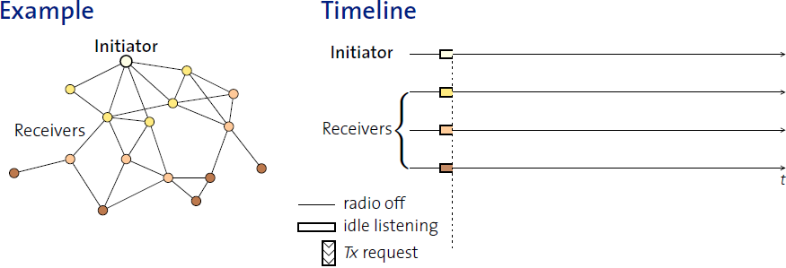
Glossy details
When Glossy starts
All nodes turn on radios to receive

Slide 123
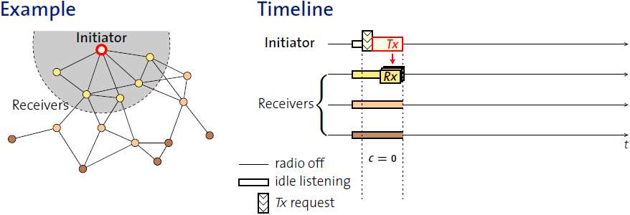
Glossy details
Initiator
Set relay counter in packet, C = 0
Broadcast packet

Slide 124
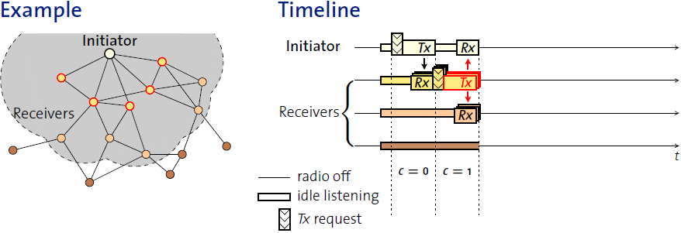
Glossy details
At packet reception:
Increment relay counter C
Transmit synchronously (at a fixed period after the reception)

Slide 125
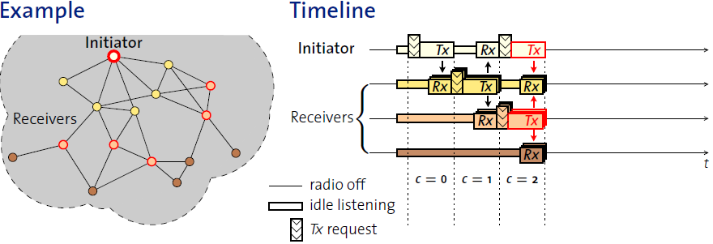
Glossy details
At packet reception:
Increment relay counter C
Transmit synchronously (at a fixed period after the reception)

Slide 126
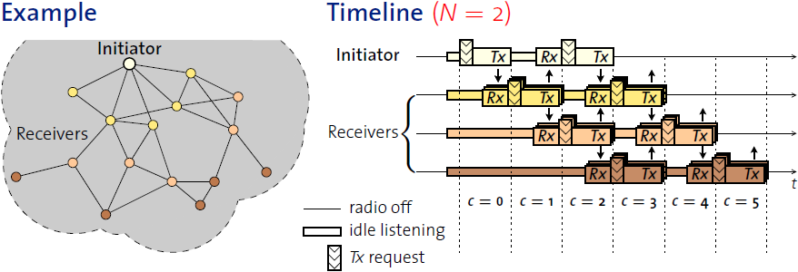
Glossy details
Stop rebroadcasting and turn off radio when
Already transmitted N times
Networks pick N for reliability/energy tradeoff

Slide 127
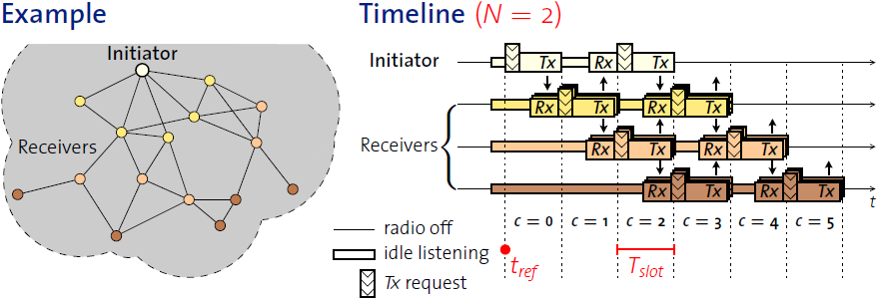
Glossy details
T_{slot} is constant by design
Needs to be to make constructive interference work
Beginning of slot (t_{ref}) provides synchronization point
As a bonus, all nodes are synchronized after flooding event

Slide 128
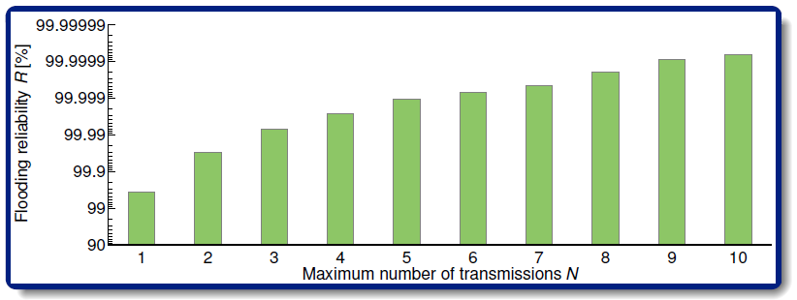
Glossy implementation
Device must be able to have tight time bounds on rx/tx
500 ns wiggle room maximum
Includes receive, processing, transmission
Need to pick an N for reliability

Slide 129
Application of Glossy: avoid routing altogether
Low-Power Wireless Bus (LWB)
Federico Ferrari, Zimmerling, Mottola, Thiele. SenSys’12
Use Glossy for all device communication
Make one broadcast domain (a bus) where all nodes communicate
Avoids all issues of routing, everything is a broadcast
Works for unicast, multicast, anycast, and broadcast transmissions
General idea: TDMA Glossy floods
Synchronization is already given to nodes by Glossy
One coordinator makes the TDMA schedule

Slide 130
RPL

Slide 131
RPL (IETF RFC 6550)
RPL- Routing over Low Power and Lossy Networks – IETF (www.ietf.org › proceedings › slides › slides-94-rtgarea-2)

Slide 132
RPL
● Distance Vector (DV) protocol
Requires that a router to inform its neighbors of topology changes periodically
Each node maintains a vector (table) of minimum distance to every node
● Source Routing Protocol
Allows a sender of a packet to partially or completely specify the route the packet takes through the network

Slide 133
RPL
(Directed Acyclic Graph)

Slide 135
Control Messages
DODAG Information Solicitation (DIS): used to solicit a DODAG Information Object from a RPL node.
DODAG Information Object (DIO) - The DODAG Information Object carries information that allows a node to discover a RPL Instance, learn its configuration parameters, select a DODAG parent set, and maintain the DODAG
RPL nodes transmit DIOs using a Trickle Timer.
Destination Advertisement Object (DAO): The Destination Advertisement Object (DAO) is used to propagate destination information Upward along the DODAG.
DAO-ACK

Slide 136
Rank-based data-path validation mechanisms
In Storing mode, the DAO message is unicast by the child to the selected parent(s).
In Non-Storing mode, the DAO message is unicast to the DODAG root.

Slide 137
Directed Diffusion (Data Centric)
Node (sink) asks for a particular kind of information, but does not know if the information exists or not
Sends a query to express an interest for specific information
Neighboring nodes act if they were the sink and forward queries to their neighbors
Only one copy of interest/query is forwarded
Flooding or propagation stops when a (source) node can satisfy an interest/query
Source node floods the answer to sink
Sink assumes that the node from which the first reply arrived is also the neighbor on the “shortest” path
Reinforce path by sending more query on this path

Slide 138
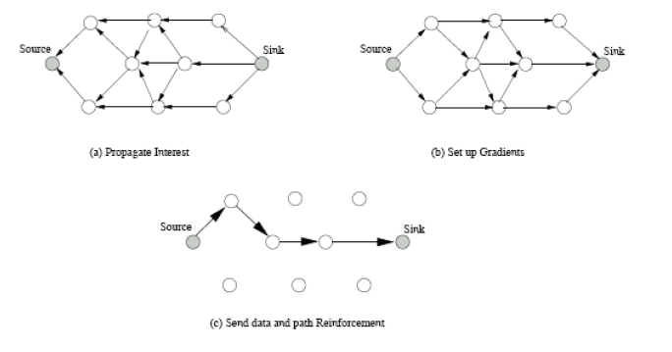
Directed Diffusion

Slide 139
Hierarchical Routing in Sensor Networks
The network consists of a Base Station (BS), away from the nodes, through which the end user can access data from the sensor network
BS can transmit with high power
Sensors cannot reply directly to the BS due to their low power constraints, resulting in asymmetric communication.
Nodes transmit only to their immediate cluster head (CH), thus saving energy
Only CH needs to perform additional computation on data (aggregation)
Adjacent cluster members have similar data

Slide 140
3.1
3.2
Base Station
3
2
3.3
2.3
1.0.1
1
2.1
1.0.2
1.2.5
1.2.4
2.2
1.0.3
1.2
1.1
1.1.3
1.1.2
1.2.3
1.2.1
1.1.4
1.2.2
1.1.1
1.1.5
Simple sensor node
First Level Cluster Head
Second Level Cluster Head

Slide 141
Directional Antennas for Co-existence on Shared Wireless Spectrum
Notes:
Begin by talking about contributions made with directional antennas to allow co-existence on shared spectrum for battery operated NES
This work was done in the firs two and half years of my PhD studies

Slide 142
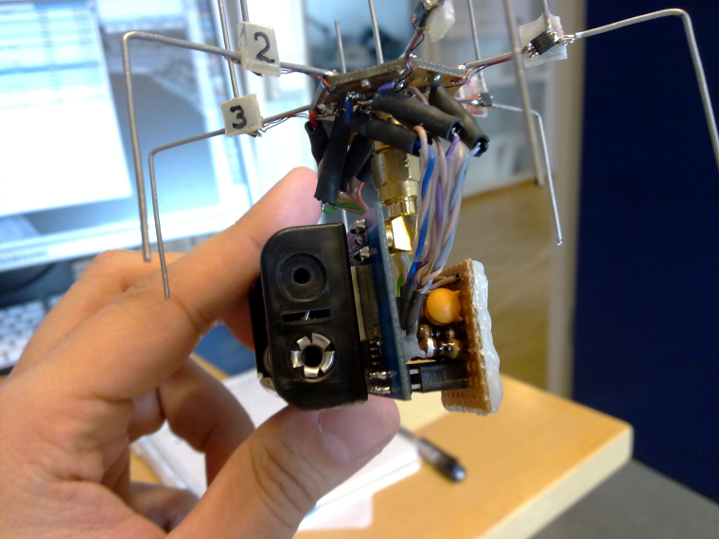
Directional Antenna for Sensing and Communication
What is a directional antenna?
Studied extensively in 1-hop networks, e.g., WiFi networks
ESD antennas are feasible, simple and inexpensive
SPIDA [1,2] - 6 configurable directions, costs < 5 USD
Power consumption of few microwatts!
[1] Erik Ostrom et al. "Evaluation of an electronically switched directional antenna for real-world low-power wireless networks” – REALWSN 2010
[2] Martin Nilsson. “Directional antennas for wireless sensor networks” - 9th Scandinavian Workshop on Wireless Adhoc Networks 2009
Notes:
- Talk about what is directional antenna
A Directional antenna radiates or receives greater power in specific directions.
An ESD or Electronically Steerable Directional antennas is a type of diretional antena that allows the electronic control of the direction of maximum antenna gain. One example of ESD antenna is the SPIDA which you can see in the slide. These antennas are feasble, simple and inexpensive. E.g., the SPIDA antenna you see on the slide can be configured to six possible antenna direction and costs only 5 USD to make.
Despite advantages offered by ESD antennas, they have not been widely used for NES. The protocols and insights from other wireless networks cannot be applied to NES as they are usually multihop in nature, and they present very different challenge as compared to 1-hop networks.
One of the reasons was lack of testbed to perform experiments with ESD antenna. Initial part of my phd studies looked at designing testbed of WSN nodes equipped with the SPIDA antenna.
Next we discuss two sensing and communication application we explored with the ESD antenna.

Slide 143
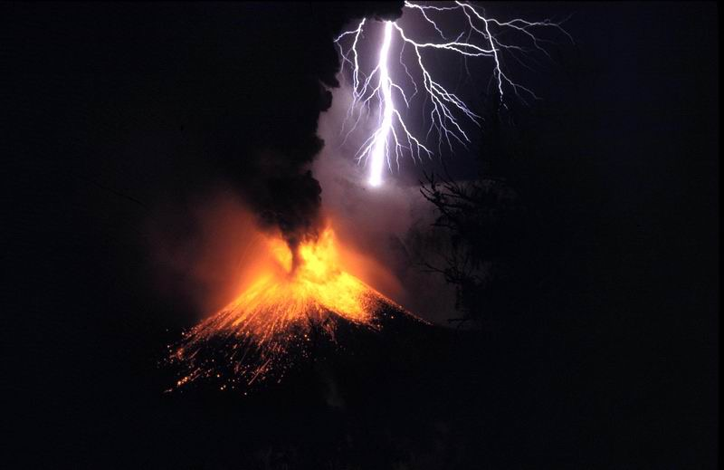

Bulk Data Transmissions
Traffic pattern of many WSN applications
Volcano monitoring [1]
Bridge monitoring [2]
Directional antenna beneficial for such applications
Increased communication range at no additional energy cost
Bulk transmission(s) most severely affected by interference
[1] Geoff Werner-Allen et al. "Fidelity and yield in a volcano monitoring sensor network” in OSDI 2016
[2] Kameswari Chebrolu et al. "Brimon: a sensor network system for railway bridge monitoring” in ACM MOBISYS 2008
Notes:
Bulk data is traffic pattern for many WSN applications, including for example volcano monitoring or structural health monitoring. The central feature of these applications is that there is large amount of sensed data that is collected and send over multi-hop low-powered wireless links to a powerful sink node for further processing. The directional antennas are beneficial for such applications as they increase the communication range at no additional energy cost, also bulk transmissions as they occupy channel for larger period of time are more severely affected by interference. However, in WSN there are no existing protocol to exploit this.

Slide 144
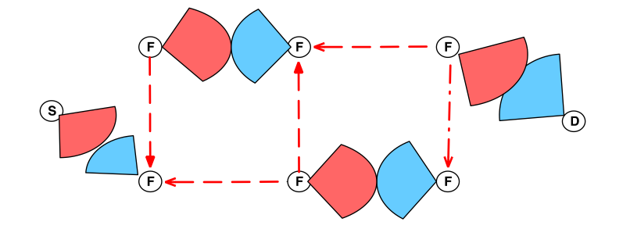
DPT’s Contributions
Directional Pipelined Transmissions (DPT)
Leverage directional transmissions and receptions
Reduce inter/intra path interference using directional communication
Highest reported throughput in 802.15.4 multi-hop links
Operation on single wireless channel
DPT creates two pipelines between source and sink
All nodes are always active!
Notes:
So our main contribution in this work is we present a protocol called DPT which leverages directional transmissions and receptions. We demonstrate that directional communication can reduce intra/inter path interference signficiantly. We further demontsrate that this reduced interapath and interpath interference allows high throughput multihop transmissions to occur on one wireless channel. We also achieve the highest reported throughput in 802.15.4 multihop links.

Slide 145
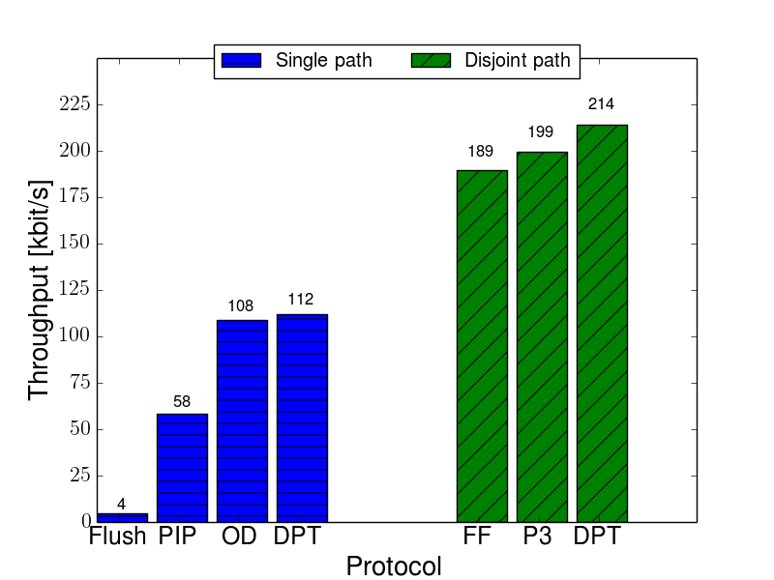
DPT Throughput Comparison
Existing protocols not designed for ESD antennas
State-of-the-art:
P3 [1] multiple channels ,higher node density
[1] Manjunath Doddavenkatappa et al. "P 3: a practical packet pipeline using synchronous transmissions for wireless sensor networks.” in ACM/IEEE IPSN 2014
Notes:
We compare the performance of DPT to the state of the art in bulk forwarding in WSN. Since these existing protocols were not designed for ESD antennas, we do not experimentally compare DPT with thesse protocols. We compare the performance of DPT with the highest reported throughput from their respective publications. As we see on the figure on the screen, DPT out performs all of the protocol in terms of highest throughput achieved for both single path and disjoint path. P3 is closest in terms of performance to DPT, however, unlike P3 we use only one wireless channel for bulk data transmission.

Slide 146
Learning Objective for Today’s Lecture
Review: last few lecture’s topics
Node Discovery
Routing
IoT/Sensor Network Routing
Flooding
RPL
Misc and Case Study

Slide 147
Wireless Networking
Ambuj Varshney
Assistant Professor, National University of Singapore
Wireless, Embedded Intelligence, Sensing, and Emerging Technologies Group
ambujv@nus.edu.sg

